Slide 1
Parallel Computer Architectures
CHAPTER 8

Slide 2
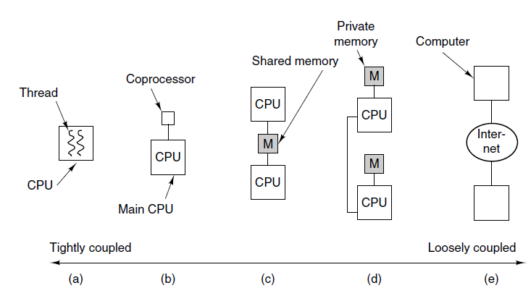
On-Chip Paralellism

Slide 3
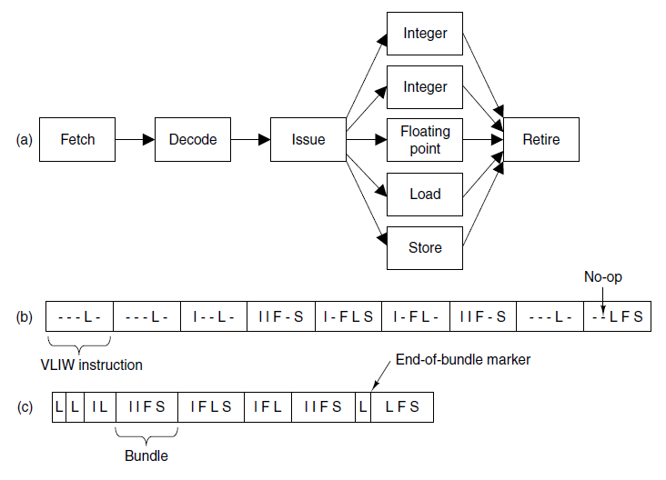
Instruction-Level Parallelism

Slide 4
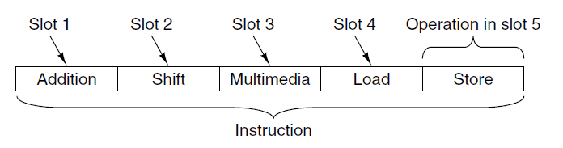
The TriMedia VLIW CPU (1)

Slide 5
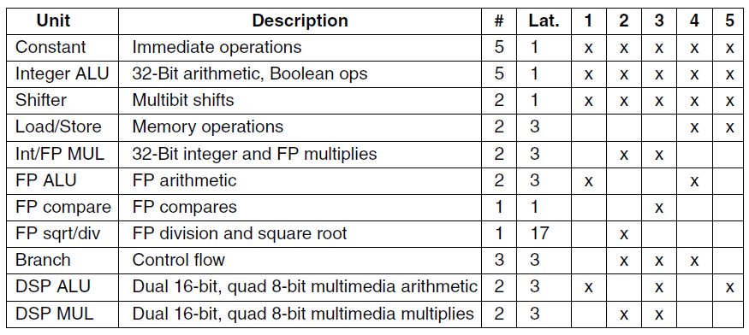
The TriMedia VLIW CPU (2)

Slide 6
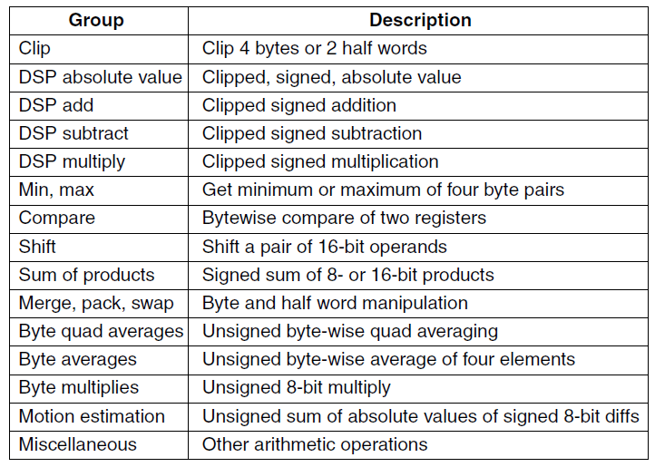
The TriMedia VLIW CPU (3)

Slide 7
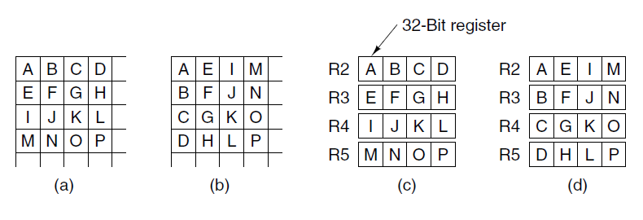
The TriMedia VLIW CPU (4)

Slide 8
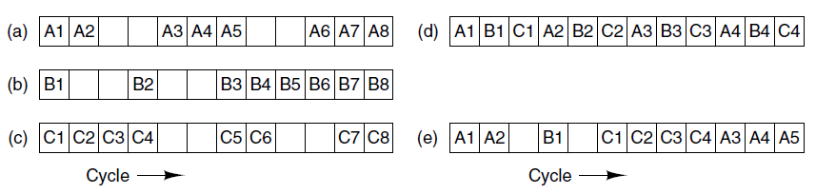
On-Chip Multithreading (1)

Slide 9
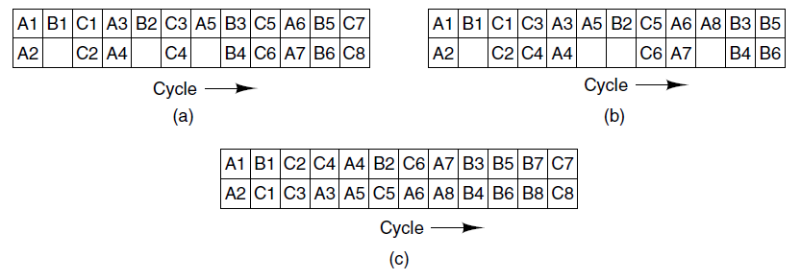
On-Chip Multithreading (2)

Slide 10
Hyperthreading on the Core i7 (1)
Increasing the clock speed
Putting two CPUs on a chip
Adding functional units
Making the pipeline longer
Using multithreading

Slide 11
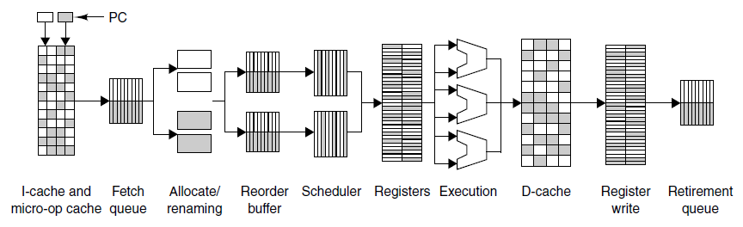
Hyperthreading on the Core i7 (2)

Slide 12
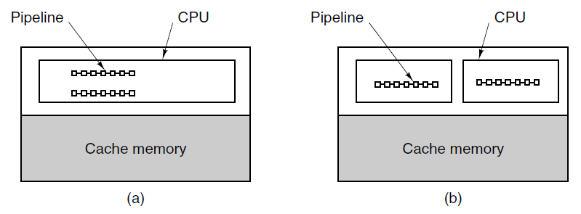
Homogeneous Multiprocessors on a Chip

Slide 13
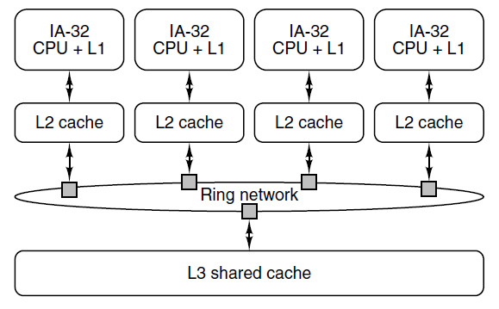
The Core i7 Single-Chip Multiprocessor

Slide 14
Heterogeneous Multiprocessors on a Chip (1)
Functions handled by computer in DVD player:
Control of cheap, servomechanism for head tracking
Analog-to-digital conversion
Error correction
Decryption and digital rights management
MPEG-2 video decompression
Audio decompression
Encoding the output for NTSC, PAL, or SECAM TV sets

Slide 15
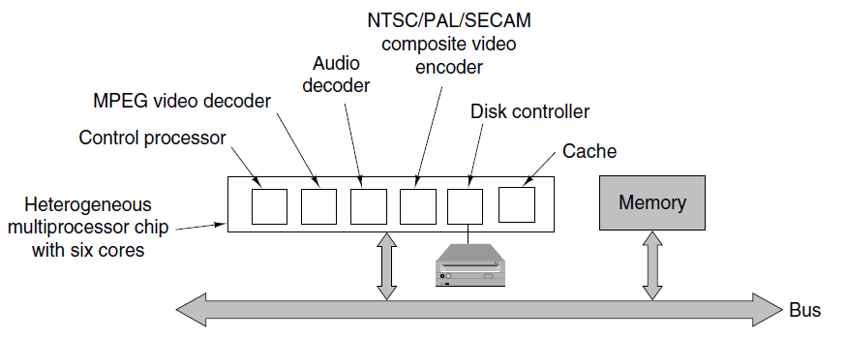
Heterogeneous Multiprocessors on a Chip

Slide 16
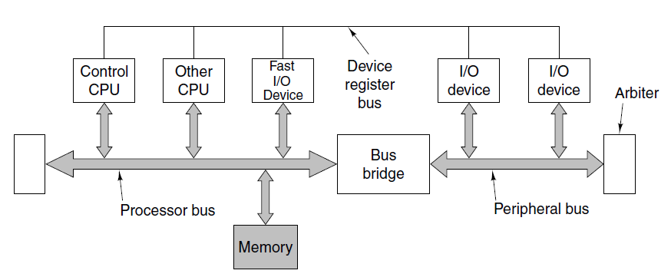
Heterogeneous Multiprocessors on a Chip

Slide 17
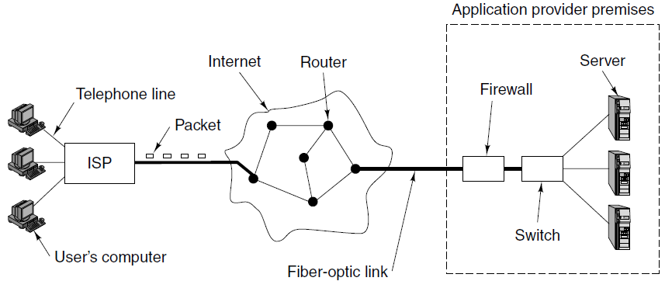
Introduction to Networking (1)
Figure 8-14. How users are connected
to servers on the Internet.

Slide 18

Introduction to Networking (2)

Slide 19
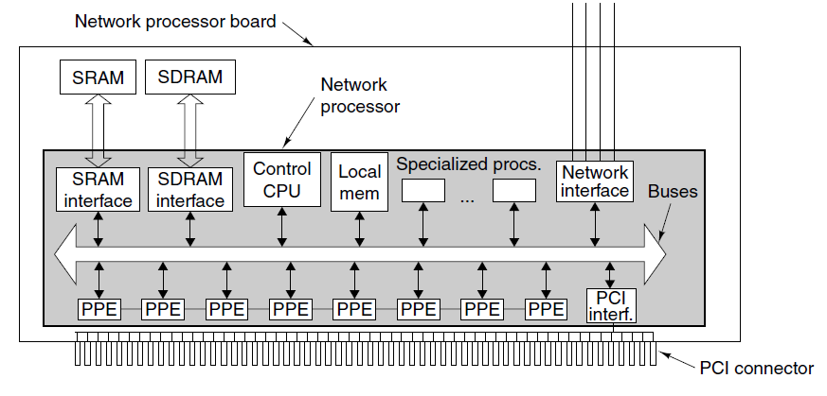
Introduction to Network Processors

Slide 20
Packet Processing (1)
Potential processing steps:
Checksum verification
Field extraction
Packet classification
Path selection
Destination network determination
Route lookup
Fragmentation and reassembly

Slide 21
Packet Processing (2)
Potential processing steps (continued):
Computation
Header management
Queue management
Checksum generation
Accounting
Statistics gathering

Slide 22
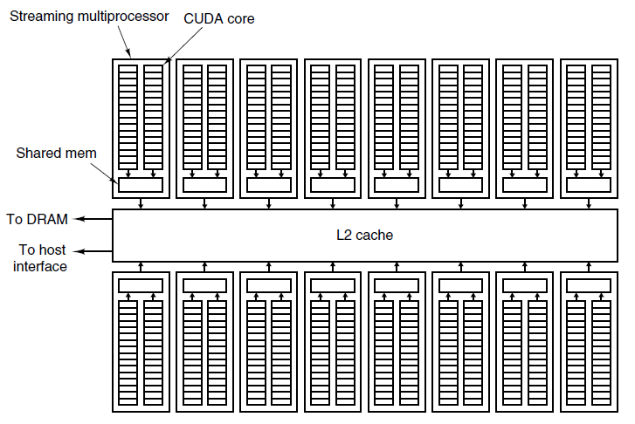
The NVIDIA Fermi GPU (1)

Slide 23
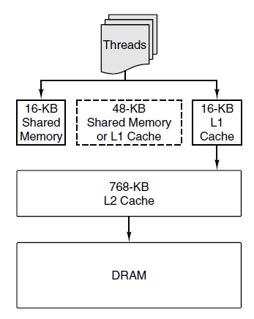
The NVIDIA Fermi GPU (2)

Slide 24
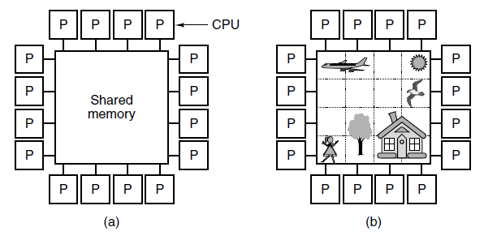
Multiprocessors

Slide 25
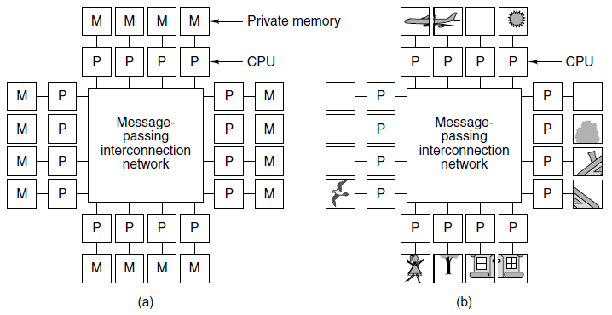
Multicomputers (1)

Slide 26
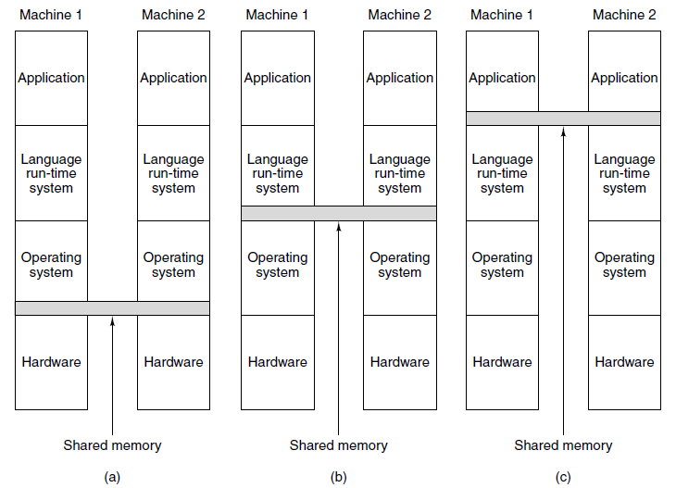
Multicomputers (2)

Slide 27
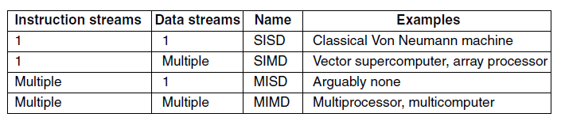
Taxonomy of Parallel Computers (1)

Slide 28
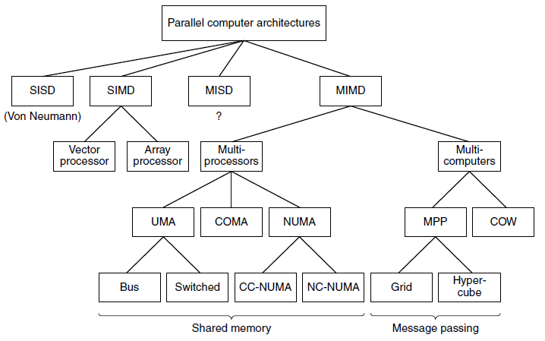
Taxonomy of Parallel Computers (2)

Slide 29
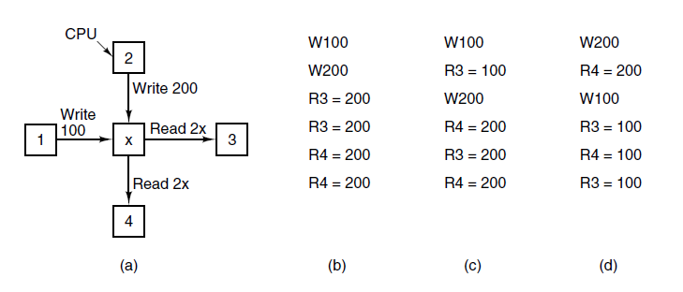
Sequential Consistency

Slide 30
Processor Consistency
Properties of processor consistency
Writes by any CPU are seen by all in order they were issued
For every memory word, all CPUs see writes to it in same
order

Slide 31
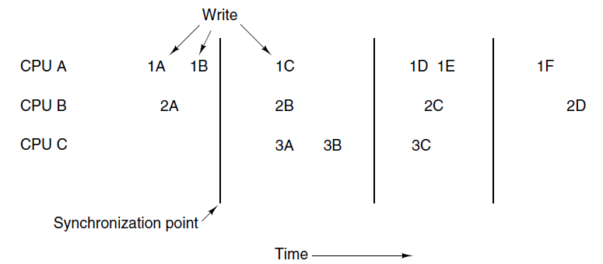
Weak Consistency

Slide 32
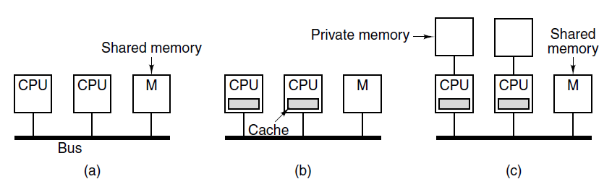
UMA Symmetric Multiprocessor Architectures

Slide 33
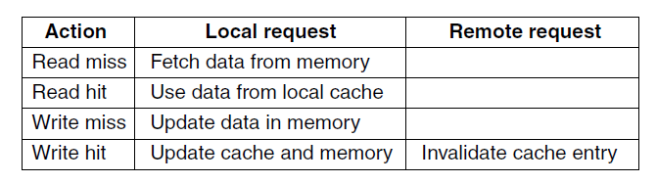
Snooping Caches

Slide 34
The MESI Cache Coherence Protocol (1)
Possible cache entry state:
Invalid – The cache entry does not contain valid data
Shared – Multiple caches may hold the line; memory is up to date
Exclusive– No other cache holds the line; memory is up to date
Modified – The entry is valid; memory is invalid; no copies exist

Slide 35
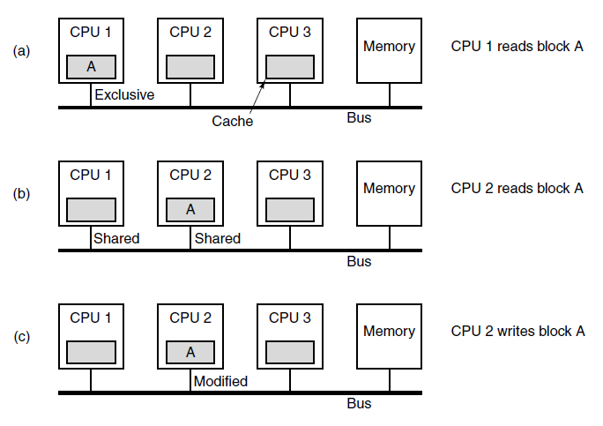
The MESI Cache Coherence Protocol (2)

Slide 36
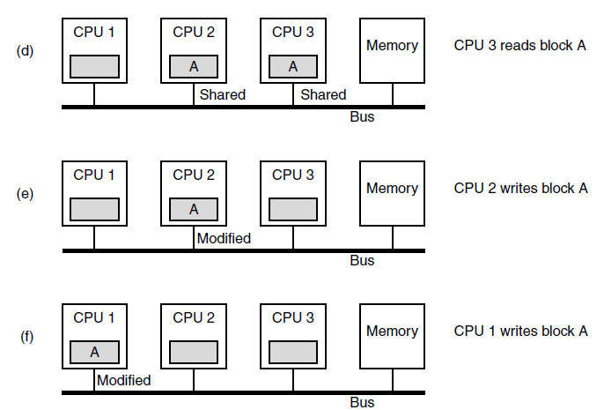
The MESI Cache Coherence Protocol (3)

Slide 37
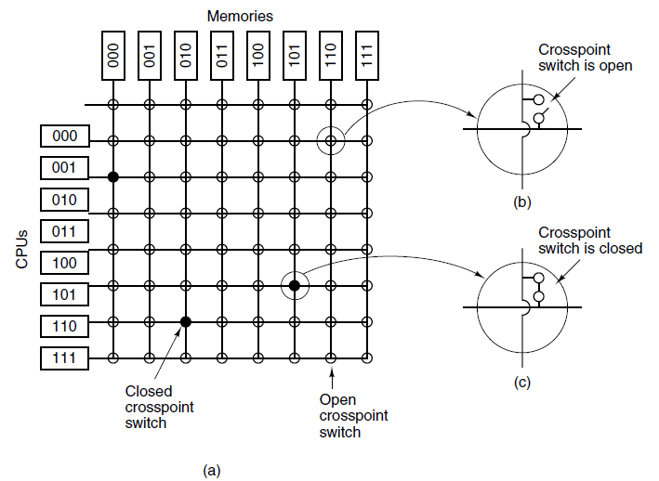
UMA Multiprocessors Using Crossbar Switches (1)

Slide 38
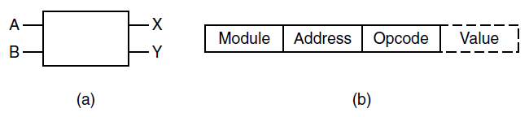
UMA Multiprocessors Using Crossbar Switches (2)

Slide 39
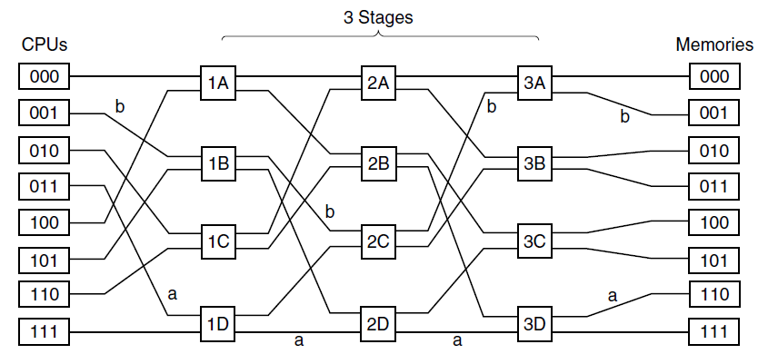
UMA Multiprocessors Using Crossbar Switches (3)
Figure 8-31. An omega switching network.

Slide 40
NUMA Multiprocessors (1)
Key characteristics of NUMA machines:
There is a single address space visible to all CPUs.
Access to remote memory done using LOADs and STOREs
Access to remote memory is slower than access to local memory

Slide 41
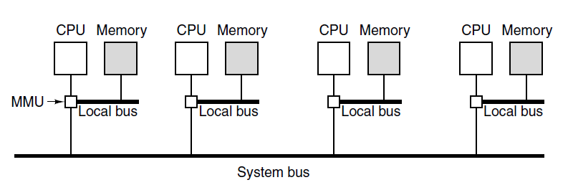
NUMA Multiprocessors (2)

Slide 42
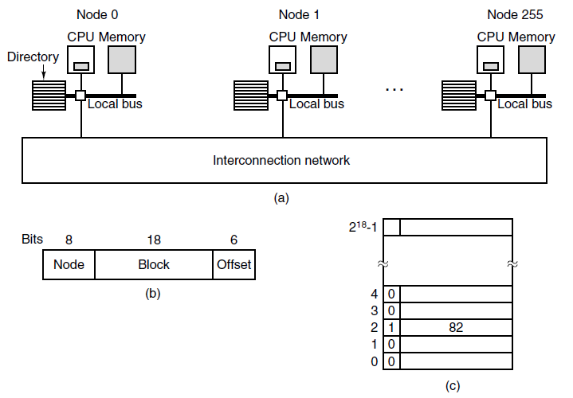
NUMA Multiprocessors (3)

Slide 43
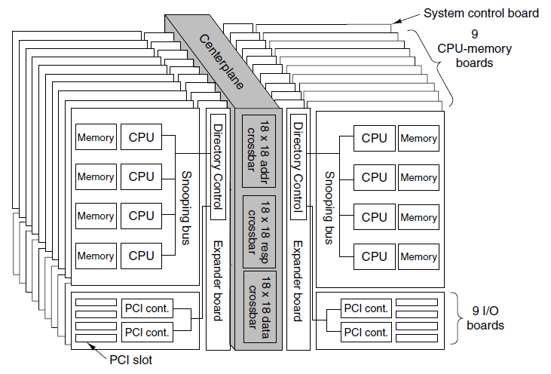
Sun Fire E25K NUMA Multiprocessor (1)

Slide 44
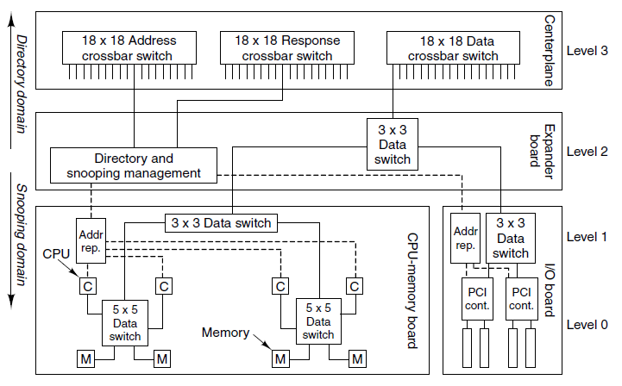
Sun Fire E25K NUMA Multiprocessor (2)

Slide 45
Sun Fire E25K NUMA Multiprocessor (3)
Memory block and cache line of each CPU chip can be in
one of three states:
Exclusive access (for writing)
Shared access (for reading)
Invalid (i.e., empty)

Slide 46
COMA Multiprocessors
COMA systems introduce two new problems:
How are cache lines located?
When a line is purged, what happens if it is the last copy?

Slide 47
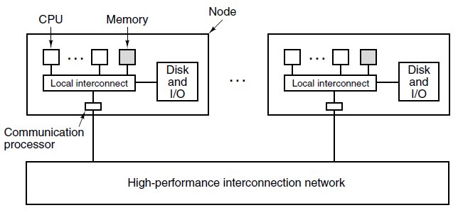
Message-Passing Multicomputers

Slide 48
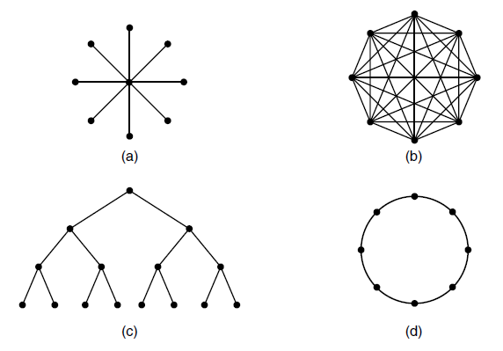
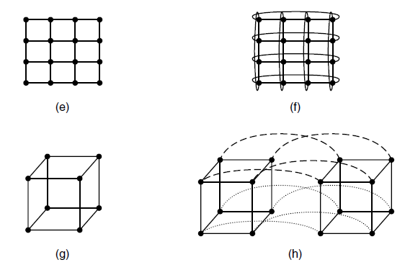
Topology

Slide 49
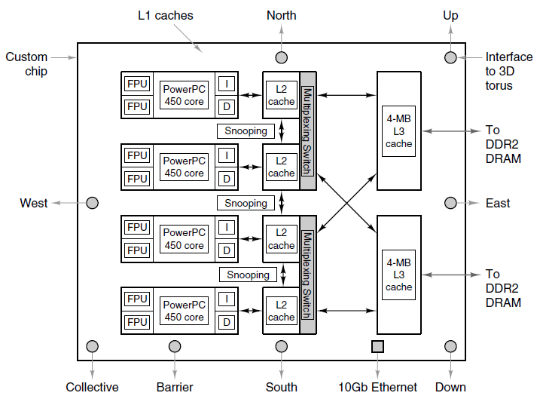
BlueGene (1)

Slide 50
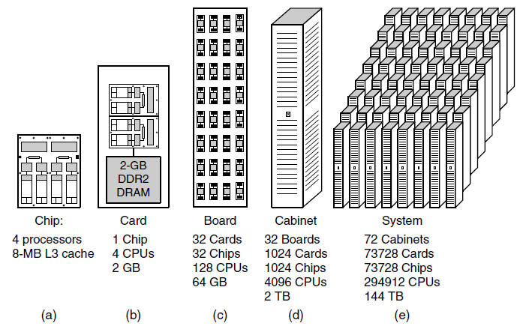
BlueGene (2)

Slide 51
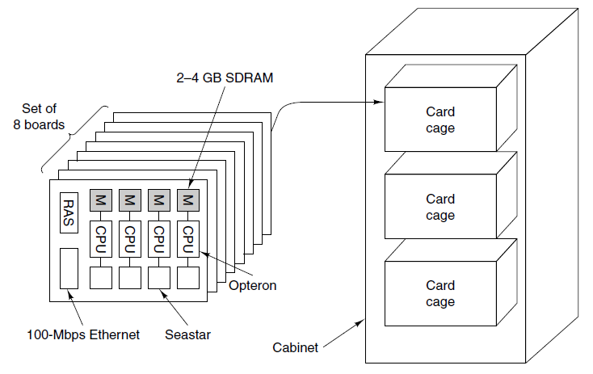
Red Storm (1)

Slide 52
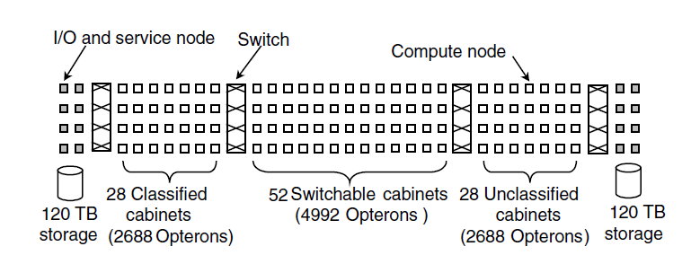
Red Storm (2)

Slide 53
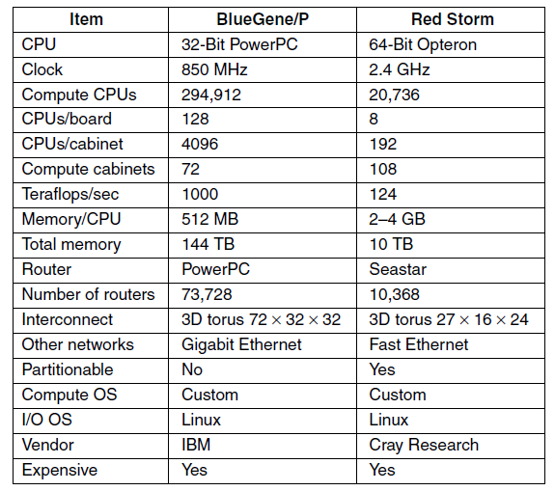
Comparison of BlueGene/P and Red Storm

Slide 54
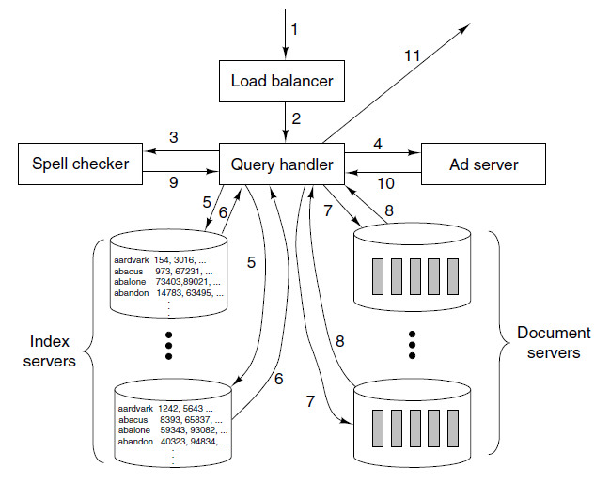
Cluster Computing – Google

Slide 55
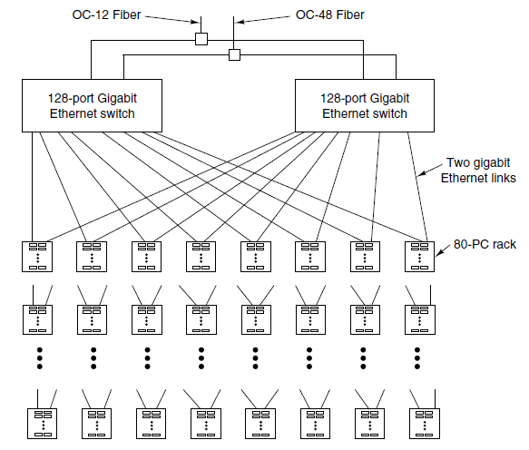
Google (1)

Slide 56
Google (2)
Google has learned 3 things about running massive Web servers:
Components will fail so plan for it
Replicate everything for throughput and availability
Optimize price/performance

Slide 57
Communication Software for Multicomputers
Three variants of semantics:
Synchronous message passing
Buffered message passing
Nonblocking message passing

Slide 58
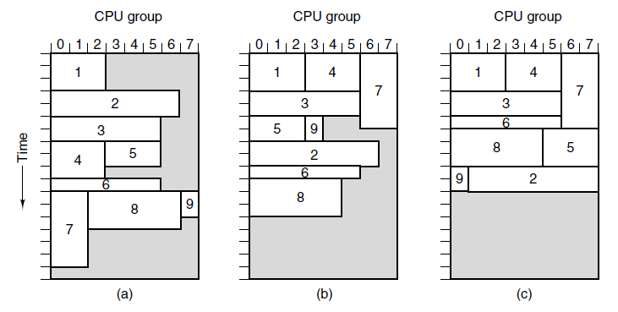
Scheduling

Slide 59
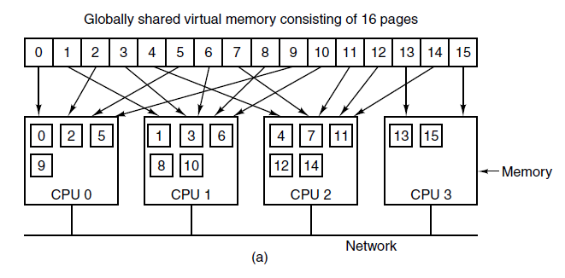
Distributed Shared Memory (1)

Slide 60
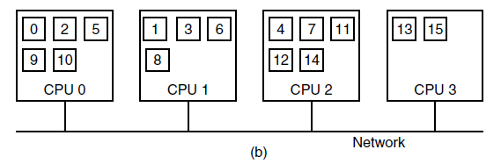
Distributed Shared Memory (2)

Slide 61
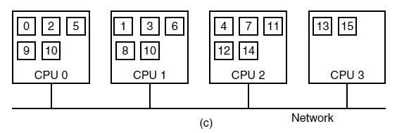
Distributed Shared Memory (3)

Slide 62
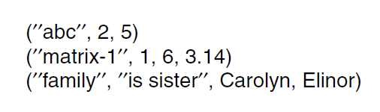
Linda (1)

Slide 63
Linda (2)
A match occurs if the following 3 conditions are all met:
The template and the tuple have the same number of fields
The types of the corresponding fields are equal
Each constant or variable in the template matches its field

Slide 64

Orca

Slide 65

Software Metrics (1)

Slide 66

Software Metrics (2)

Slide 67

Achieving High Performance

Slide 68
Grid Computing (1)
Challenges involving large scale, interdisciplinary resources:
Scientists developing a mission to Mars.
A consortium building a dam or aircraft
An international team coordinating aid after a natural disaster

Slide 69

Grid Computing (2)

Slide 70
Grid Computing (3)
Categories of standards:
Infrastructure services
Resource management services
Data services
Context services
Information services
Self-management services
Security services
Execution management services

Slide 71
End
Chapter 8

